Slide 1
Mobile First,
A Flexible Mindset

Slide 2
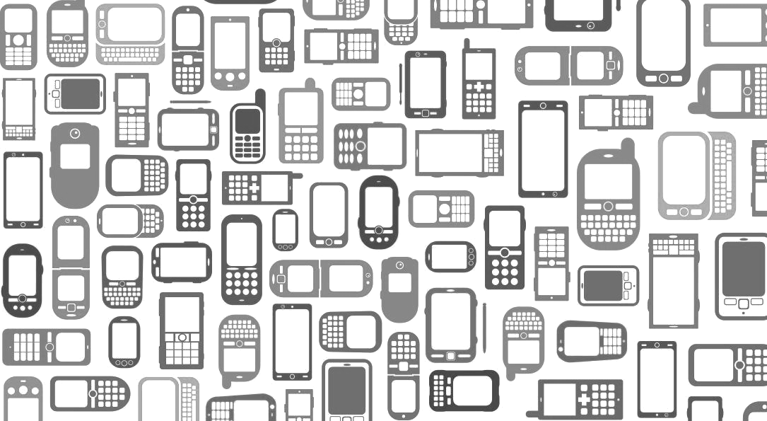
Hello!
I’m Brad
Front-End Warlock at Vixlet

Slide 3
Why do we care?
1
Mobile Dominance in Today’s Society

Slide 4
39% of the world will have smartphones by the start of 2015, and over 301.3 million were sold in both Q2 & Q3 of 2014.
-IDC Research Analysis
(http://www.idc.com/prodserv/smartphone-os-market-share.jsp)

Slide 5



Programmers <3 Math
Let’s think about this - today alone...
371,124 Babies Born
559,891 TVs Sold
165,042 Cars Produced

Slide 6

3,347,778 Mobile Devices were Sold
9x over today’s birthrate
6x more than TVs sold today
20x more than today’s car production

Slide 7
Mobile Web
Zillow
Recently stated that 45% of all traffic on their listings was from mobile devices.
Vixlet + MLB
In a recent contest we ran for World Series Tickets, the traffic average saw...
59% Mobile
17% Tablet
24% Desktop

Slide 8
So How Do We Start?
2
Starting Light = Ending Up With Less

Slide 9
So How Do We Start?
Limit projects to smaller processor & ram specs
Limit plugin usage to essentials when possible
Prioritize info so it’s streamlined for implementation as well as user consumption.

Slide 10
Every Action Begets A Reaction
3
Choose your stylization with purpose

Slide 11
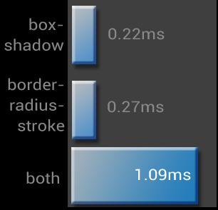
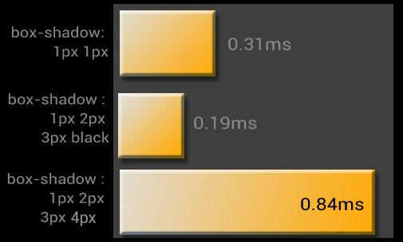
Even CSS can induce page rendering latency:
Compounded styles exponentially increase paint times.
http://www.html5rocks.com/en/tutorials/speed/css-paint-times/

Slide 12
Under The Hood
4
Technical Tidbits to Streamline The Workflow

Slide 13
Under The Hood
A Look at Your Thumbs
Most elements for thumbs tend to be happiest at 44-50px.
Pseudo Classes Rock
Whenever possible, use CSS instead of JS. Comma divided lists for simple example:
.like-list a:not(:last-child):after {
content: “,”;
}
Ex: Ally, Greg, Joe like this.

Slide 14
CSS Columns
Responsive layouts can benefit greatly from columns as they help you collapse sections of text gracefully without needing many <p>’s
article {
/* 2 col, 200px wide min (otherwise stack) - Column-count & column-width */
-webkit-columns: 2 200px;
-moz-columns: 2 200px;
columns: 2 200px;
/* Gutter space between columns (Defaults to 1em) - Note: Can’t do negatives */
-webkit-column-gap: 4em;
-moz-column-gap: 4em;
column-gap: 4em;
/* Sets the divider between columns should you desire one */
-webkit-column-rule: 1px dotted #ddd;
-moz-column-rule: 1px dotted #ddd;
column-rule: 1px dotted #ddd;
}
More Info: http://css-tricks.com/guide-responsive-friendly-css-columns/

Slide 15
Min & Max-width Are Your friends!
Setting up for tons of screen sizes will make you go insane, responsive & mobile first are basically twin brothers.
/* CONTAINERS - Keep container at 90% of boundary width, not always at 800px */
.container {
max-width: 90%;
width: 800px;
}
/* IMAGES - Keep responsive in containing divs as they collapse through sizes*/
img {
max-width: 100%;
height: auto;
}
/* NOTE : For ie8: add in width:auto or do… */
@media /0screen {
img { width: auto; }
}
/* INPUTS - Keep Inputs responsive, but give widely usable structure to them */
input {
max-width: 500px;
min-width: 240px;
width: 100%;
}

Slide 16
Viewport Based Parameters are Helpful!
vw & vh are percentages based upon the viewport width and height respectively, and work well in responsive environments.
: SIMPLE EXAMPLE USAGES :
/* Set a div to be 50% the viewport width, and 25% its height */
.greg {
width: 50vw;
height: 25vh;
}
/* Makes a border 1% the width of the viewport - say maybe its a vignette style wrap around the viewport perhaps */
.outerborder {
border: 1vw solid #0FF;
}

Slide 17
Media Queries & SASS Work Well Together
We love SASS at Vixlet, and we all know about media queries, but when combined properly we can get some powerful voodoo going.
: Example #1 : Simple Extends in Media Breakdowns
SASS:
.errorOne { font-size: 1.2em; }
.errorTwo { font-size: 1.5em; }
@media only screen and (max-width: 300px){
.errorTwo {
@extend .errorOne;
color: blue;
}
}
Media Query Compiles to:
@media only screen and (max-width: 300px){
.errorTwo {
font-size: 1.2em;
color: blue;
}
}
http://thesassway.com/intermediate/responsive-web-design-in-sass-using-media-queries-in-sass-32

Slide 18
: Example #2 : Simple Mixins with Variables & Media Queries
//SASS:
$break-medium 480px;
$break-large: 1024px;
.profile-pic {
float: left;
width: 250px;
@media screen and (min-width: $break-medium){
width: 350px;
float: none;
}
@media screen and (min-width: $break-large){
float: right;
}
}
//COMPILES TO:
.profile-pic {
float: left;
width: 250px;
}
@media screen and (min-width: 480px){
.profile-pic {
width: 100px;
float: none;
}
}
@media screen and (min-width: 1024px){
.profile-pic {
float: right;
}
}
http://thesassway.com/intermediate/responsive-web-design-in-sass-using-media-queries-in-sass-32

Slide 19
: Example #3 : Whole Query as a SASS Variable
//SASS:
$info-phone: “only screen and (max-width:320px)”;
@media #{$info-phone} {
.greg {
background: #0ff;
}
}
//COMPILES TO:
@media only screen and (max-width: 320px){
.greg {
background: #0ff;
}
}
http://thesassway.com/intermediate/responsive-web-design-in-sass-using-media-queries-in-sass-32

Slide 20
: Example #4 : Let’s Step It Up
//SASS:
$break-small: 320px;
$break-large: 1024px;
@mixin respond-to ($media) {
@if $media == handhelds {
@media only screen and (max-width: $break-small) { @content; }
}
@else if $media == medium-screens {
@media only screen and
(min-width: $break-small + 1) and
(max-width: $break-large - 1) { @content; }
}
@else if $media == wide-screens {
@media only screen and (min-width: $break-large) { @content; }
}
}
.profile-pic {
float: left;
width: 250px;
@include respond-to(handhelds) { width: 100% ;}
@include respond-to(medium-screens) { width: 125px; }
@include respond-to(wide-screens) { float: none; }
}
http://thesassway.com/intermediate/responsive-web-design-in-sass-using-media-queries-in-sass-32

Slide 21
: Example #4 : Let’s Step It Up
//COMPILES TO:
.profile-pic {
float: left;
width: 250px;
}
@media only screen and (max-width: 320px) {
.profile-pic {
width: 100%;
}
}
@media only screen and (min-width: 321px) and (max-width: 1023px) {
.profile-pic {
width: 125px;
}
}
@media only screen and (min-width: 1024px) {
.profile-pic {
float: none;
}
}
http://thesassway.com/intermediate/responsive-web-design-in-sass-using-media-queries-in-sass-32

Slide 22
Pixel Density & Images
For mobile, retina and serving things in various pixel densities has become commonplace. This is a simplified example of the usage.
: Example : Retina Usage with single query
/* Regular Resolution image setup */
.my-image {
background-image: url(‘/img/non-retina.jpg’);
}
/* Retina screens, sometimes its better support to do 1.5 as this hits certain android screens as well */
@media
(-webkit-min-device-pixel-ratio: 2),
(min-resolution: 192dpi){
.my-image {
background-image: url(‘/img/retina@2x.jpg’);
}
}
Notes:
Remember that if you wrap both one higher than 2 and less than 2 then you get only 1 image instead of two on a retina display

Slide 23
SVG is Easy
SVG is basically a vector on a webpage, able to easily scale to any size and lets you avoid fooling with retina images altogether.
-IE 9+, Android 2.3+ support
-Color svg using styling even
-Directly embed code or use as img
-Save directly from Illustrator easily now
: Example : SVG as background image
.main-header {
background:url(logo.svg) top left / contain no-repeat;
}
.no-svg .main-header {
background-image: url(logo.jpg);
}
http://css-tricks.com/using-svg/

Slide 24






Resources for Covered Topics
Media Queries
Good site for breakdowns of media queries should you seek some example stuff on them.
http://cssmediaqueries.com/overview.html
More on Paint Times
This is where a lot of the timings for the css items paint times came from, great article full of info.
http://www.html5rocks.com/en/tutorials/speed/css-paint-times/
SASS Mastery
Thesassway.com is a great site for learning SASS in an intuitive and easy fashion, with many examples borrowed from here. http://thesassway.com/intermediate/responsive-web-design-in-sass-using-media-queries-in-sass-32
Boston Globe
Good example of collapsed responsive, the weather item collapses in a unique, but intuitive manner, first showing up in the navbar in a nice
http://brolik.com/blog/responsive-web-design-examples-with-css-tips-and-tricks/
Using SVG
Good resource on the utilization and implementation of SVG Graphics
http://css-tricks.com/using-svg/
Discover Mobile
Good walkthrough of a solid design process start to finish, showcases the whole design flow.
http://kathrynjamesfaulkner.com/mobile-first/index.html

Slide 25
Thanks!
ANY QUESTIONS?
brad@vixlet.com

Slide 26








































































































